Slide 1
CS 514 / ECE 558 Computer Networks
Transport Layer: TCP and QUIC
Slides courtesy of David Choffnes and Christo Wilson

Slide 2
Transport Layer
Function:
Demultiplexing of data streams
Optional functions (e.g., TCP):
Creating long lived “connections”
Reliable, in-order packet delivery
Error detection
Flow control and congestion control
Key challenges:
Detecting and responding to congestion
Balancing fairness against high utilization
Application
Transport
Network
Data Link
Physical

Slide 3
End-to-end Argument
``The function in question can completely and correctly be implemented only with the knowledge and help of the application standing at the end points of the communication system. Therefore, providing that questioned function as a feature of the communication system itself is not possible.’’
End-to-end arguments in system design, J. H. Saltzer, D. P. Reed, and D. D. Clark, ACM Transactions on Computer Systems, Vol. 2, No. 4, Nov. 1984, pp. 277–288

Slide 4
TCP Header Fields
0
4
16
31
Used to detect out of order, duplicate, and missing packets
Source Port
Destination Port
Sequence Number
Acknowledgement Number
Header length. Default length is 20 bytes, but may be longer with options.
HLen
Flags
Advertised Window
Checksum
Urgent Pointer
Options
Used for flow control (protecting the receiver from overloading)
Used for connection establishment (SYN), acknowledgement (ACK), connection close (FIN), and errors (RST).
Not used.

Slide 5
Connection Setup
Why do we need connection setup?
To establish state on both hosts
Most important state: sequence numbers
Count the number of bytes that have been sent
Initial value chosen at random
Why?
Important TCP flags (1 bit each)
SYN – synchronization, used for connection setup
ACK – acknowledge received data
FIN – finish, used to tear down connection

Slide 6
Three Way Handshake
Client
Server
SYN <SeqC, 0>
Why
Sequence # +1?
SYN/ACK <SeqS, SeqC+1>
ACK <SeqC+1, SeqS+1>
Each side:
Notifies the other of starting sequence number
ACKs the other side’s starting sequence number (+1)
Sequence # must increment on receiving a SYN
Notes:
211

Slide 7
Sequence Number Space
TCP uses a byte stream abstraction
Initial, random values selected during setup
Each byte in each stream is numbered
32-bit value, wraps around
Byte stream broken down into segments (packets)
Size limited by the Maximum Segment Size (MSS, typically 1460 bytes)
Set to limit fragmentation
Each segment has a sequence number
13450
14950
16050
17550
Segment 8
Segment 9
Segment 10

Slide 8
Bidirectional Communication
Seq.
Ack.
Client
Server
Seq.
Ack.
1
23
Data (1460 bytes)
23
1
23
1461
Data/ACK (730 bytes)
1461
753
Data/ACK (1460 bytes)
Data and ACK in the same packet
753
2921
Each side of the connection can send and receive
Different sequence numbers for each direction

Slide 9
Flow Control
Problem: how many packets should a sender transmit?
Too many packets may overwhelm the receiver
Size of the receiver's buffers may change over time
Solution: sliding window
Receiver tells the sender how big their buffer is
Called the advertised window
For window size n, sender may transmit n bytes without receiving an ACK
After each ACK, the window slides forward
Advertised window may go to zero!

Slide 10
Flow Control: View from the Sender Side
Packet Sent
Packet Received
Src. Port
Dest. Port
Src. Port
Dest. Port
Sequence Number
Sequence Number
Acknowledgement Number
Acknowledgement Number
HL
Flags
Adv. Window
HL
Flags
Adv. Window
Checksum
Urgent Pointer
Checksum
Urgent Pointer
Must be buffered until ACKed
sock.send()
Buffer of Bytes to Send
ACKed
Sent
To Be Sent
Outside Window
Window
Notes:
Each side acts and sender and receiver
Every message contains sequence number, even if payload length is zero
Every message contains acknowledgements, even if no data was received
Every message advertises the window size

Slide 11
What Should the Receiver ACK?
ACK every packet
Use cumulative ACK, where an ACK for sequence n implies ACKS for all k < n
Use negative ACKs (NACKs), indicating which packet did not arrive
Use selective ACKs (SACKs), indicating those that did arrive, even if not in order
SACK is an actual TCP extension

Slide 12
Error Detection
Checksum detects (some) packet corruption
Computed over IP header, TCP header, and data
Sequence numbers catch sequence problems
Duplicates are ignored
Out-of-order packets are reordered or dropped
Missing sequence numbers indicate lost packets
Lost segments detected by sender
Use timeout to detect missing ACKs
Need to estimate RTT to calibrate the timeout
Sender must keep copies of all data until ACK

Slide 13
Retransmission Time Outs (RTO)
Problem: time-out is linked to round trip time
Timeout is too short
Initial Send
Initial Send
RTO
RTO
ACK
Retry
Retry
What about if timeout is too long?
ACK

Slide 14
Round Trip Time Estimation
Data
RTT Sample
ACK
Original TCP round-trip estimator
RTT estimated as a moving average
new_rtt = α (old_rtt) + (1 – α)(new_sample)
Recommended α: 0.8-0.9 (0.875 for most TCPs)
RTO = 2 * new_rtt (i.e. TCP is conservative)

Slide 15
What is Congestion?
Load on the network is higher than capacity
Capacity is not uniform across networks
Modem vs. Cellular vs. Cable vs. Fiber Optics
There are multiple flows competing for bandwidth
Residential cable modem vs. corporate datacenter
Load is not uniform over time
10pm, Sunday night = BitTorrent Game of Thrones

Slide 16
Why is Congestion Bad?
Results in packet loss
Routers have finite buffers, packets may be dropped
Practical consequences
Router queues build up, delay increases
Wasted bandwidth from retransmissions
Low network goodput

Slide 17
The Danger of Increasing Load
Congestion Collapse
Knee – point after which
Throughput increases very slowly
Delay increases quickly
In an M/M/1 queue
Delay = 1/(1 – utilization)
Cliff – point after which
Throughput → 0
Delay → ∞
Knee
Cliff
Goodput
Ideal point
Load
Delay
Load

Slide 18
Cong. Control vs. Cong. Avoidance
Congestion Avoidance:
Stay left of the knee
Congestion Control:
Stay left of the cliff
Knee
Cliff
Congestion Collapse
Goodput
Load

Slide 19
Advertised Window, Revisited
Does TCP’s advertised window solve congestion?
NO
The advertised window only protects the receiver
A sufficiently fast receiver can max the advertised window (i.e. 2¹⁶ bytes)
What if the network is slower than the receiver?
What if there are other concurrent flows?
Key points
Window size determines send rate
Window must be adjusted to prevent congestion collapse

Slide 20
Goals of Congestion Control
Adjusting to the bottleneck bandwidth
Adjusting to variations in bandwidth
Sharing bandwidth between flows
Maximizing throughput

Slide 21
General Approaches
Do nothing, send packets indiscriminately
Many packets will drop, totally unpredictable performance
May lead to congestion collapse
Reservations
Pre-arrange bandwidth allocations for flows
Requires negotiation before sending packets
Must be supported by the network
Dynamic adjustment
Use probes to estimate level of congestion
Speed up when congestion is low
Slow down when congestion increases
Messy dynamics, requires distributed coordination

Slide 22
TCP Congestion Control
Introduce a congestion window (cwnd) at the sender
Congestion control is a sender-side problem
Controls the number of unACKed packets
Separate variable, but bounded by the receiver’s advertised window
Sending rate is ~ congestion window/RTT
Why is the sending rate (inversely) proportional to RTT?
Recall that TCP is ACK-clocked
Idea: vary the window size to control the send rate

Slide 23
Two Basic Components
Detect congestion
Packet dropping is most reliable signal
Delay-based methods are hard and risky
How do you detect packet drops? ACKs
Timeout after not receiving an ACK
Several duplicate ACKs in a row (starting in TCP Reno)
Rate adjustment algorithm
Modify cwnd
Probe for bandwidth
Respond to congestion
Except on wireless networks

Slide 24
Rate Adjustment
Recall: TCP is ACK clocked
Congestion = delay = long wait between ACKs
No congestion = low delay = ACKs arrive quickly
Basic algorithm
Upon receipt of ACK: increase cwnd
Data was delivered, perhaps we can send faster
cwnd growth is proportional to RTT
On loss: decrease cwnd
Data is being lost, there must be congestion
Question: what increase/decrease functions to use?

Slide 25
Utilization and Fairness
Max throughput for flow 2
More than full utilization (congestion)
Equal throughput
(fairness)
Less than full utilization
Ideal point
Max efficiency
Perfect fairness
Flow 2 Throughput
Zero throughput for flow 1
Zero throughput for flow 2
Max throughput for flow 1
Flow 1 Throughput

Slide 26
Additive Increase, Multiplicative Decrease
Converges to stable and fair cycle
Symmetric around y=x
Flow 2 Throughput
Flow 1 Throughput

Slide 27
Implementing Congestion Control
Maintains three variables:
cwnd: congestion window
adv_wnd: receiver advertised window
ssthresh: slow start threshold (used to update cwnd)
For sending, use: wnd = min(cwnd, adv_wnd)
Two phases of congestion control
Slow start (cwnd < ssthresh)
Probe for bottleneck bandwidth
Congestion avoidance (cwnd >= ssthresh)
AIMD

Slide 28
Slow Start
Goal: reach knee quickly
Upon starting (or restarting) a connection
cwnd =1
ssthresh = adv_wnd
Each time a segment is ACKed, cwnd++
Continues until…
ssthresh is reached
Or a packet is lost
Slow Start is not actually slow
cwnd increases exponentially
Knee
Cliff
Goodput
Load

Slide 29
Slow Start Example
cwnd = 1
cwnd grows rapidly
Slows down when…
cwnd >= ssthresh
Or a packet drops
1
cwnd = 2
2
3
cwnd = 4
4
5
6
7
cwnd = 8

Slide 30
Congestion Avoidance
AIMD mode
ssthresh is lower-bound guess about location of the knee
If cwnd >= ssthresh then each time a segment is ACKed cwnd += 1/cwnd
So cwnd is increased by one only if all segments have been acknowledged

Slide 31
Congestion Avoidance Example
cwnd = 1
cwnd = 2
cwnd >= ssthresh
cwnd = 4
ssthresh = 8
cwnd (in segments)
Slow Start
cwnd = 8
cwnd = 9
Round Trip Times

Slide 32
TCP Pseudocode
Initially: cwnd = 1; ssthresh = adv_wnd;
New ack received: if (cwnd < ssthresh) /* Slow Start*/ cwnd = cwnd + 1; else /* Congestion Avoidance */ cwnd = cwnd + 1/cwnd;
Timeout: /* Multiplicative decrease */ ssthresh = cwnd/2; cwnd = 1;

Slide 33
The Big Picture
ssthresh
Timeout
Congestion
Avoidance
cwnd
Slow Start
Time

Slide 34
The Evolution of TCP
Thus far, we have discussed TCP Tahoe
Original version of TCP
However, TCP was invented in 1974!
Today, there are many variants of TCP
Early, popular variant: TCP Reno
Tahoe features, plus…
Fast retransmit
Fast recovery

Slide 35
TCP Reno: Fast Retransmit
Problem: in Tahoe, if segment is lost, there is a long wait until the RTO
Reno: retransmit after 3 duplicate ACKs
cwnd = 1
1
1
cwnd = 2
2
3
2
3
cwnd = 4
4
5
6
7
3
3 Duplicate ACKs
3
3

Slide 36
TCP Reno: Fast Recovery
After a fast-retransmit set cwnd to cwnd/2 then, enter Congestion Avoidance
i.e. don’t reset cwnd to 1
Avoid unnecessary return to slow start
Prevents expensive timeouts
But when RTO expires still do cwnd = 1
Return to slow start, same as Tahoe
Indicates packets aren’t being delivered at all
i.e., congestion must be really bad
Initially: cwnd = 1; ssthresh = adv_wnd;
New ack received: if (cwnd < ssthresh) /* Slow Start*/ cwnd = cwnd + 1; else /* Congestion Avoidance */ cwnd = cwnd + 1/cwnd;
3 duplicate acks: cwnd = cwnd/2; goto Cong Avoid
Timeout:
/* Multiplicative decrease */ ssthresh = cwnd/2;
cwnd = 1;

Slide 37
Fast Retransmit and Fast Recovery
ssthresh
Timeout
Congestion Avoidance
Fast Retransmit/Recovery
Timeout
cwnd
Slow Start
Time
At steady state, cwnd oscillates around the optimal window size
TCP always forces packet drops

Slide 38
Many TCP Variants…
Tahoe: the original
Slow start with AIMD
Dynamic RTO based on RTT estimate
Reno: fast retransmit and fast recovery
NewReno: improved fast retransmit
Each duplicate ACK triggers a retransmission
Problem: >3 out-of-order packets causes pathological retransmissions
Vegas: delay-based congestion avoidance
And many, many, many more…

Slide 39
TCP in the Real World
What are popular variants today?
Key problem: TCP performs poorly on high bandwidth-delay product networks (like the modern Internet)
Compound TCP (Windows)
Based on Reno
Uses two congestion windows: delay based and loss based
Thus, it uses a compound congestion controller
TCP CUBIC (Linux)
Enhancement of BIC (Binary Increase Congestion Control)
Window size controlled by cubic function
Parameterized by the time T since the last dropped packet
TCP BBR (Google)
QUIC [Not really TCP]

Slide 40
High Bandwidth-Delay Product
Key Problem: TCP performs poorly when
The capacity of the network (bandwidth) is large
The delay (RTT) of the network is large
bandwidth * delay is large
b * d = maximum amount of in-flight data in the network
a.k.a. the bandwidth-delay product
Why does TCP perform poorly?
Slow start and additive increase are slow to converge when bandwidth is large
TCP is ACK clocked
i.e. TCP can only react as quickly as ACKs are received
Large RTT → ACKs are delayed → TCP is slow to react

Slide 41
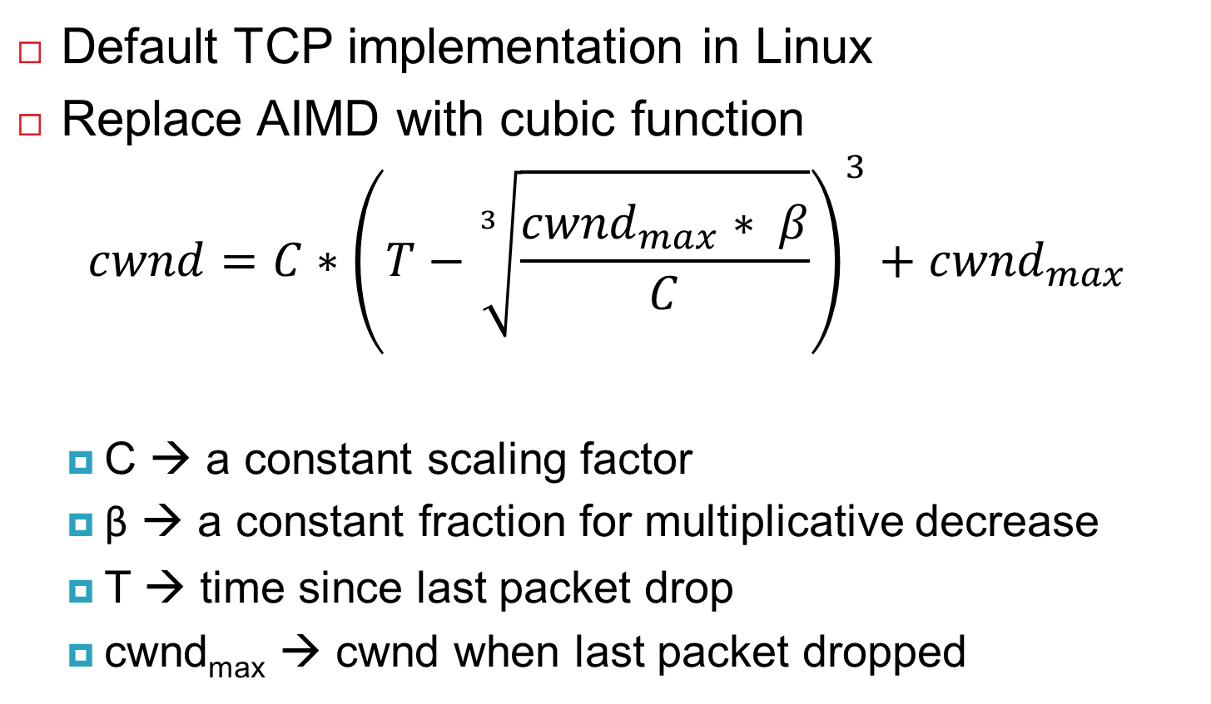
TCP CUBIC Implementation
Default TCP implementation in Linux
Replace AIMD with cubic function
$$cwnd=C∗{\left(T−\sqrt[3]{\frac{{cwnd}_{max}∗ β}{C}}\right)}^{3}+{cwnd}_{max}$$
C → a constant scaling factor
β → a constant fraction for multiplicative decrease
T → time since last packet drop
cwnd_{max} → cwnd when last packet dropped

Slide 42
TCP CUBIC Example
Slowly accelerate to probe for bandwidth
CUBIC Function
Timeout
cwnd_{max}
cwnd
Stable
Region
Slow Start
Fast ramp up
Time
Less wasted bandwidth due to fast ramp up
Stable region and slow acceleration help maintain fairness
Fast ramp up is more aggressive than additive increase
To be fair to Tahoe/Reno, CUBIC needs to be less aggressive

Slide 43
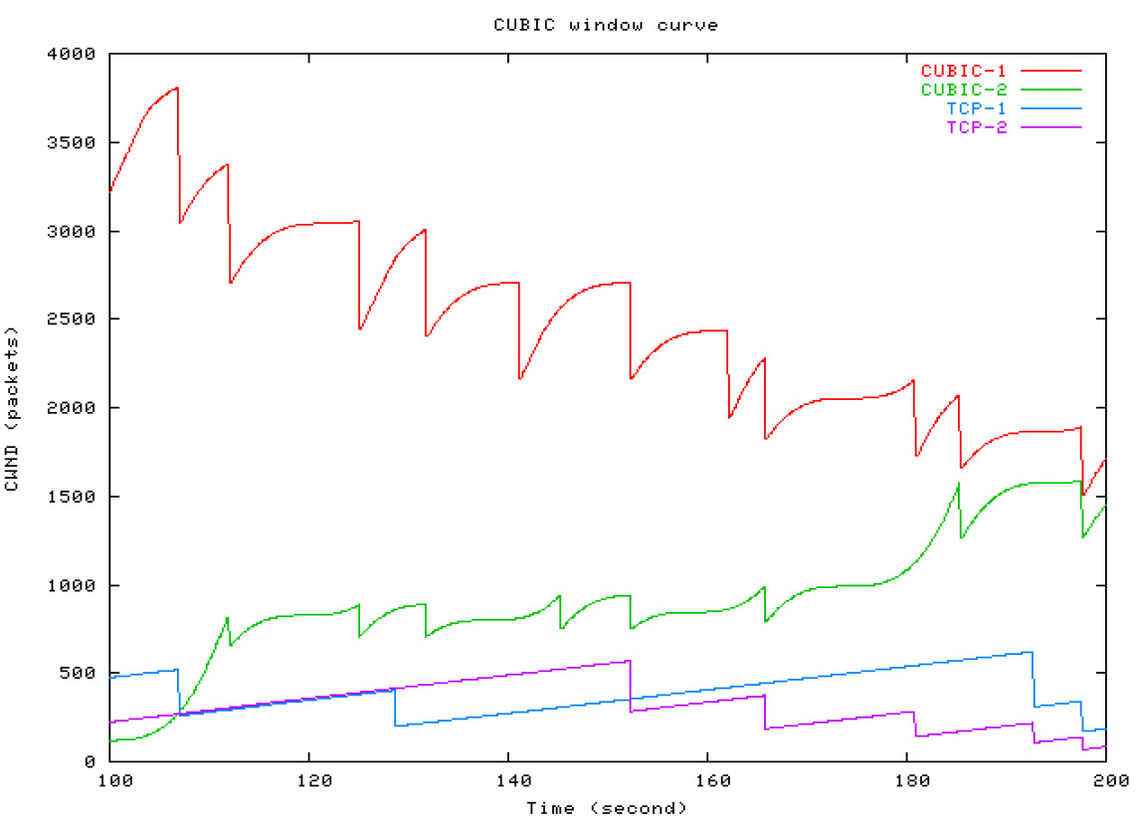
Simulations of CUBIC Flows
CUBIC
CUBIC
Reno
Reno

Slide 44
Deploying TCP Variants
TCP assumes all flows employ TCP-like congestion control
TCP-friendly or TCP-compatible
Violated by UDP :(
If new congestion control algorithms are developed, they must be TCP-friendly
Be wary of unforeseen interactions
Variants work well with others like themselves
Different variants competing for resources may trigger unfair, pathological behavior

Slide 45
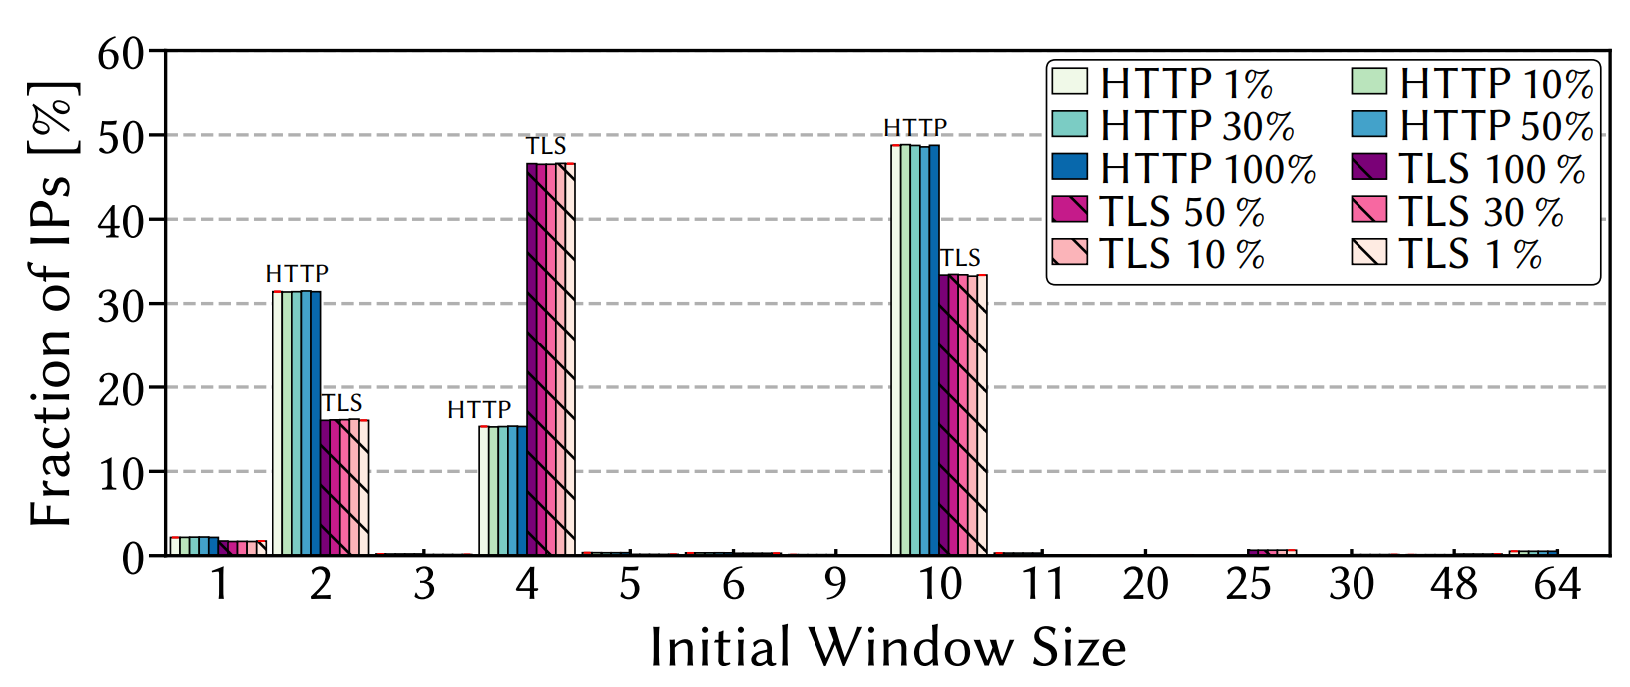
Initial Window Size
What should be the initial value of cwnd?
Too small – flows take longer to leave slow start
Too big – new flows create burst of traffic that may congest networks
Subject of ongoing debate
E.g. Linux kernel officially adopted cwnd = 10 in 2011
What sizes are in use today?
Jan Rüth, Christian Bormann, Oliver Hohlfeld. Large-scale Scanning of TCP’s Initial Window. IMC 2017.

Slide 46
SACK: Selective Acknowledgment
Problem: duplicate ACKs only tell us about 1 missing packet
Multiple rounds of dup ACKs needed to fill all holes
Solution: selective ACK
Include received, out-of-order sequence numbers in TCP header
Explicitly tells the sender about holes in the sequence
4
5
6
7
4
8
9
4
10
11
4
4
4

Slide 47
Issues with TCP
Most Internet traffic is TCP
However, many issues with the protocol
Lack of fairness
Synchronization of flows
Poor performance with small flows
Really poor performance on wireless networks
Susceptibility to denial of service

Slide 48
Synchronization of Flows
Oscillating, but high overall utilization
Ideal bandwidth sharing
cwnd
cwnd
In reality, flows synchronize
One flow causes all flows to drop packets
Periodic lulls of low utilization
cwnd

Slide 49
Small Flows
Problem: TCP is biased against short flows
1 RTT wasted for connection setup (SYN, SYN/ACK)
cwnd always starts at a low number (10 as of ~2017)
Vast majority of Internet traffic is short flows
Mostly HTTP transfers, <100KB
Most TCP flows never leave slow start!
Proposed solutions
Increase initial cwnd to a larger value, e.g., 64
TCP Fast Open: use cryptographic hashes to identify receivers, eliminate the need for three-way handshake

Slide 50
Wireless Networks
Problem: Tahoe and Reno assume loss = congestion
True on the WAN, bit errors are very rare
False on wireless, interference is very common
TCP throughput ~ 1/sqrt(drop rate)
Even a few interference drops can kill performance
Possible solutions:
Break layering, push data link info up to TCP
Use delay-based congestion detection (TCP Vegas)
Explicit congestion notification (ECN)
Routers mark the 1-bit ECN field in the TCP header to indicate congestion

Slide 51
Denial of Service
Problem: TCP connections require state
Initial SYN allocates resources on the server
State must persist for several minutes (RTO)
SYN flood: send enough SYNs to a server to allocate all memory/meltdown the kernel
Solution: SYN cookies
Idea: don’t store initial state on the server
Securely insert state into the sequence number in the SYN/ACK packet
Client will reflect the state back to the server

Slide 52
SYN Cookies
0
5
8
31
Sequence Number
Timestamp
MSS
Crypto Hash of Client IP & Port
Did the client really send me a SYN recently?
Timestamp: freshness check
Cryptographic hash: prevents spoofed packets
Maximum segment size (MSS)
Usually stated by the client during initial SYN
Server should store this value…
Reflect the client’s value back through them

Slide 53
SYN Cookies in Practice
Advantages
Effective at mitigating SYN floods
Compatible with all TCP versions
Only need to modify the server
No need for client support
Disadvantages
MSS limited to 3 bits, may be smaller than clients actual MSS
Server forgets all other TCP options included with the client’s SYN
SACK support, window scaling, etc.

Slide 54
TCP BBR
Motivation: Loss does not always imply congestion
Key idea: Model the bottleneck bandwidth rate using two properties
Bottleneck bandwidth (btlBw)
Propagation RTT (RTprop)
Send data using pacing so that one BDP of data is in flight at a time
BDP = btlBw x Rtprop
Send rate limited by cwnd or pacing_rate (pacing_gain × BtlBw)
Cwnd capped to 2 x BDP (to overcome delays in received acks)

Slide 55
TCP BBR
BBR constantly measures BtlBw and Rtprop
Measuring BtlBw
Finds maximum observed delivery rate over past 10 RTTs
Periodically increases send rate to 1.25 x BtlBw to search for more bandwidth
Measuring Rtprop
Finds min RTT over past 10 seconds based on ACKs
Problem: BBR may induce queueing delays by sending to fast
Solution: Periodically “drain” queues by sending at 25% less than BtlBw

Slide 56
TCP BBR problems
Assumes delay increases correspond to congestion
Does not work for short queues, and leads to incorrect BtlBw estimates
Fairness

Slide 57
QUIC
Quick UDP Internet Connections
Deployed by Google in 2013
Now an Internet standard (part of HTTP/3)
Provides reliable in-order byte streams, but using UDP
Motivation
Experimenting with TCP is difficult to do quickly at scale (OS changes)
Privacy/integrity violations are critical, so encrypt everything
QUIC is intended to replace TCP, TLS, and HTTP/2

Slide 58
QUIC Features
“0-RTT” connection establishment
Allows resumption of connections if client/server have communicated before
No expensive 3-way handshake or TLS connection setup
Reduced “head of line” blocking
Packet loss impacting one HTTP/2 stream does not affect others in the same connection
Improved congestion control
Solves ACK ambiguity (lost packets vs retransmission vs out of order delivery)
More precise timing information for RTT estimates
Packet pacing to avoid bursty losses
Window no longer pinned to last unACKed packet
Pluggable CC algorithms (Cubic, BBR)
Much, much more

Slide 59
QUIC Problems
Fairness
(5 Mbps link, RTT=36ms, buffer = 30KB)
QUIC gets same bandwidth regardless of number of competing flows

